Slide 1
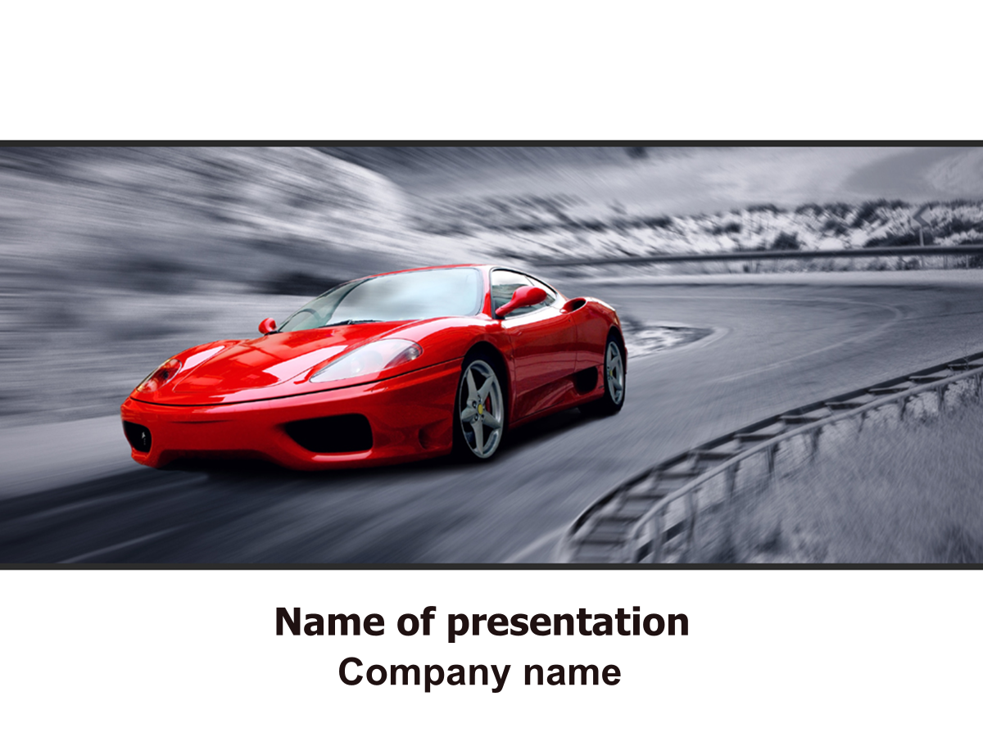
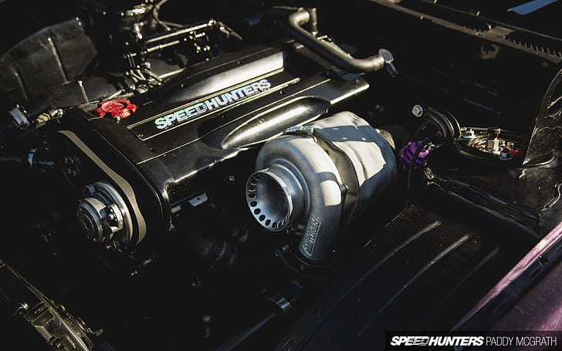
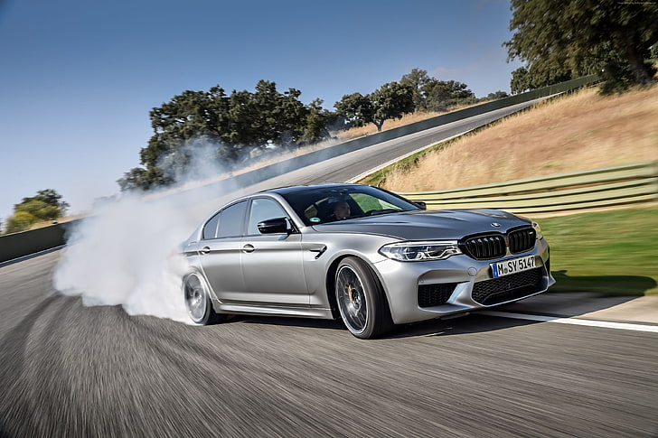
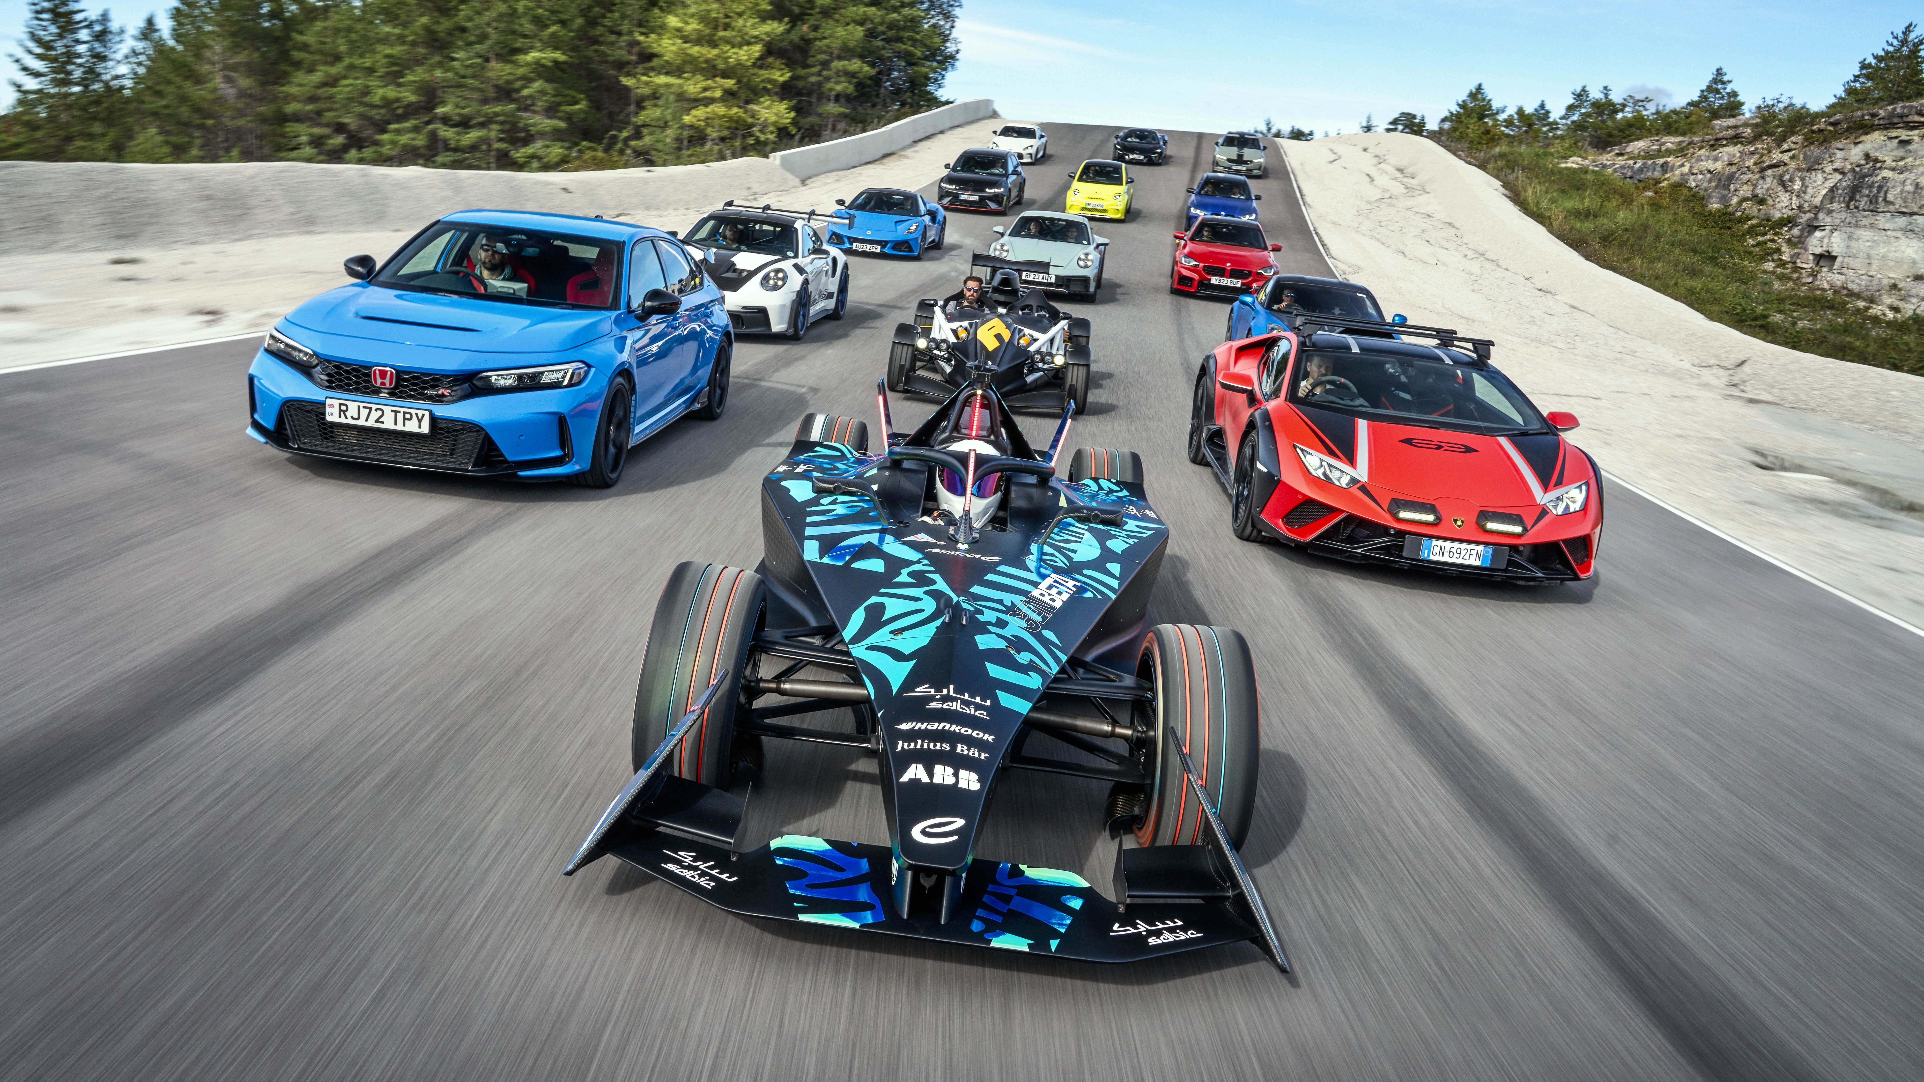
Impact of Car Features on Price and Profitability
Prepared by : Shivam Singh
Email id: Shivamkumsingh@gmail.com

Slide 2

Contents
Project Description
Approach
Tech-Stack Used
Data Analytics Task
Insights and Dashboard
Result and Conclusion

Slide 3
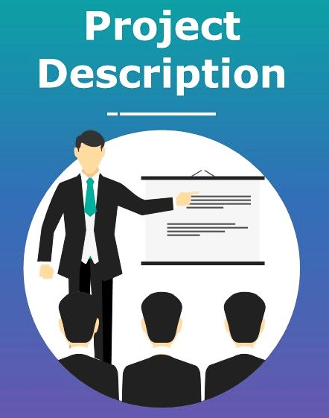
Project Description
This project aims to help a car manufacturer optimize pricing and product development by analyzing the relationship between car features, market segments, and pricing.
Using techniques like regression analysis and market segmentation, the goal is to identify high-demand and high-profit features to guide strategic decisions. This data-driven approach will support competitive pricing, meet evolving consumer preferences, and improve overall profitability in a rapidly changing automotive market.

Slide 4

Approach
Data Extraction: Downloaded and Imported the dataset into Excel.
Data Cleaning: Cleaned the data by removing missing or invalid entries and converting into required values.
Analysis: Used Pivot Tables and charts to visualize trends and uncover key insights and analyzed the findings and compiled them into a report.

Slide 5



Tech-Stack Used
Microsoft Excel 2019: Used for data cleaning and visualizations. Excel provides powerful tools like charts, graphs, pivot tables, and various formatting options that make it easier to analyze and interpret data effectively.
Microsoft PowerPoint 2019: Used for structuring and presenting insights.
Google Drive: Used for storing and sharing reports.

Slide 6

Data Analytics Task
The Dataset contains total of 11915 rows and 16 columns in all and consists of Missing values/Blanks/Null values.
16 columns and 11200 rows were used for analysis after doing data cleaning.
Missing values were imputed by Median/Mode for Numeric and Categorical variables respectively.
All the Insights are based on Sheet – “Dataset_Cleaned”
Pivot Tables were used to get the Average or Sum of the Variables.
All the Charts are attached to respective tasks.
Charts attached in “Dashboard” sections are working with Slicers directly linked with source data – Excel.
Click here for the Dataset

Slide 7
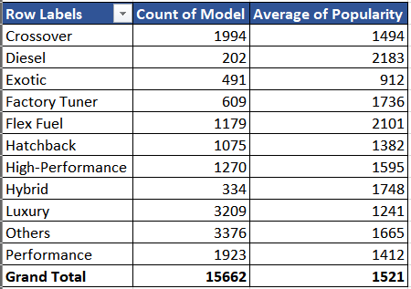
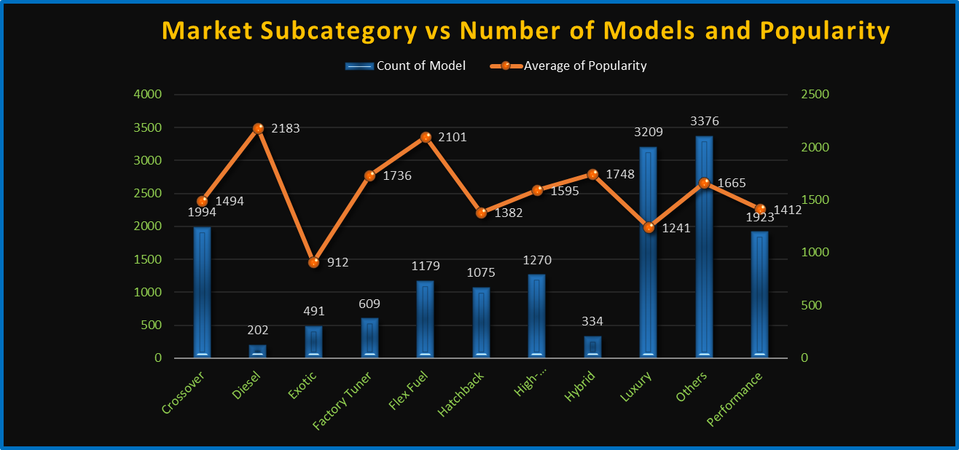
Insights
Insights Required: How does the popularity of a car model vary across different market categories?
1.A: Create a pivot table that shows the number of car models in each market category and their corresponding popularity scores.
1.B: Create a combo chart that visualizes the relationship between market category and popularity.

Slide 8
Diesel & Flex Fuel:
Few models (Diesel: 202, Flex Fuel: 1,179) but highest popularity (2,183 & 2,101) → Strong demand for fuel-efficient options.
Luxury:
Most models (3,209) but low popularity (1,241) → Oversupply or price barriers may limit appeal.
High-Performance:
Moderate models (1,270) with above-average popularity (1,595) → Niche but loyal audience.
Exotic:
Rare (491 models) and unpopular (912) → Exclusivity doesn’t guarantee demand.
Factory Tuner:
Low volume (609 models), high popularity (1,736) → Targeted appeal outperforms broader categories.
High model count ≠ high popularity. For example, "Luxury" leads in models but ranks low in popularity, while "Diesel" has few models but high demand.
Opportunity: Brands could invest in high-popularity segments (e.g., Flex Fuel) or reevaluate strategies for low-popularity, high-volume categories (e.g., Luxury).

Slide 9
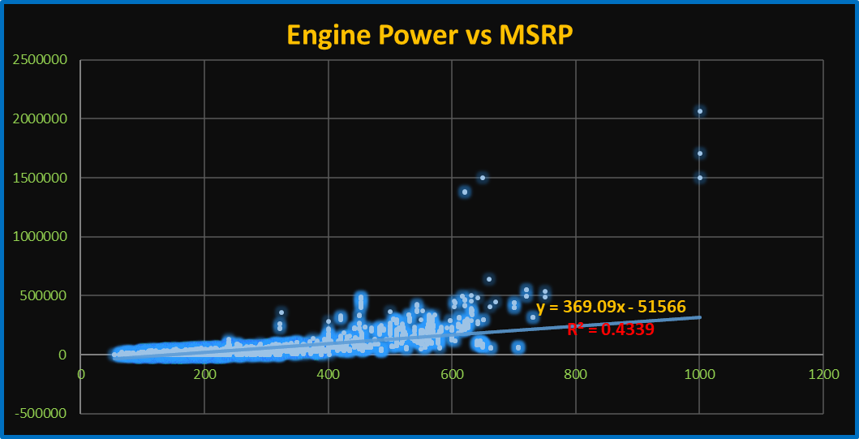
Insight Required: What is the relationship between a car's engine power and its price?
2: Create a scatter chart that plots engine power on the x-axis and price on the y-axis. Add a trendline to the chart to visualize the relationship between these variables.
The analysis reveals a positive linear relationship between a car’s engine horsepower (HP) and its price (MSRP). Vehicles with higher engine power generally command higher prices, indicating that performance is a key driver of cost.
The trendline equation shows the rate at which price increases with horsepower.
The R² value indicates how strongly engine power explains the variation in price — a higher R² suggests a stronger correlation.

Slide 10
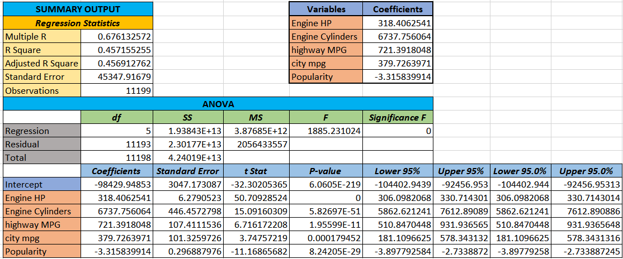
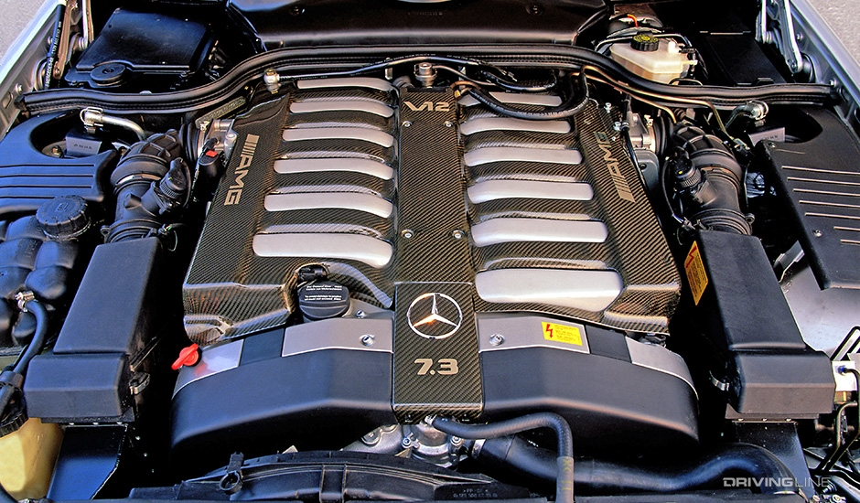
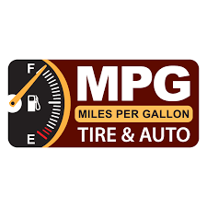
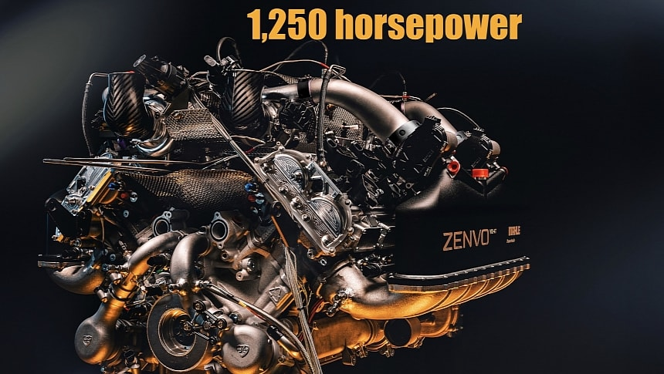
Insight Required: Which car features are most important in determining a car's price?
3: Use regression analysis to identify the variables that have the strongest relationship with a car's price. Then create a bar chart that shows the coefficient values for each variable to visualize their relative importance.

Slide 11
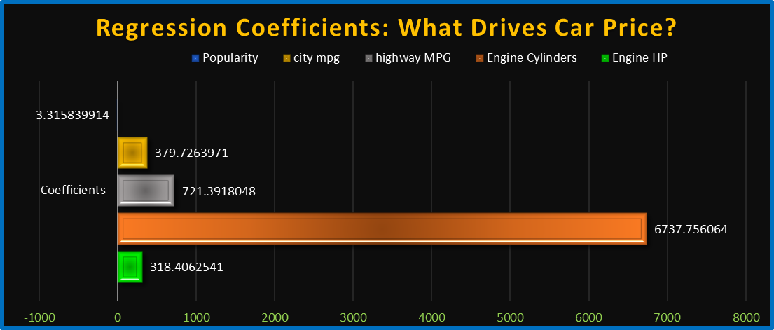
The regression analysis reveals that certain car features have a stronger impact on price (MSRP) than others:
Engine Horsepower (HP): Higher HP strongly correlates with higher price — a key indicator of performance.
Engine Cylinders: More cylinders usually suggest a more powerful or premium engine, increasing cost.
Highway and City MPG: These have a weaker or even negative relationship — fuel efficiency is often higher in
more affordable cars.
Popularity: This can have a mild influence, depending on brand demand.

Slide 12
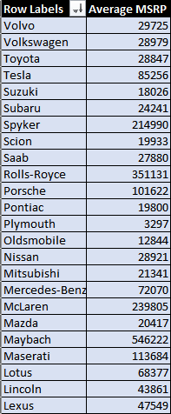
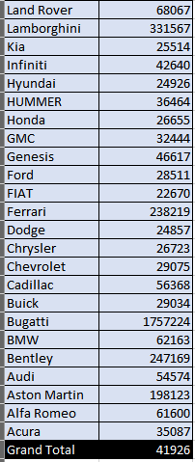
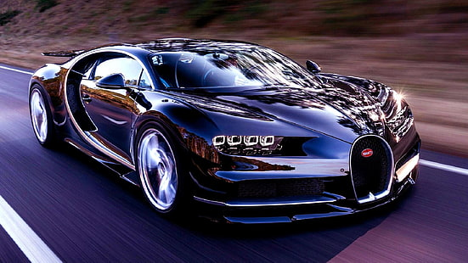
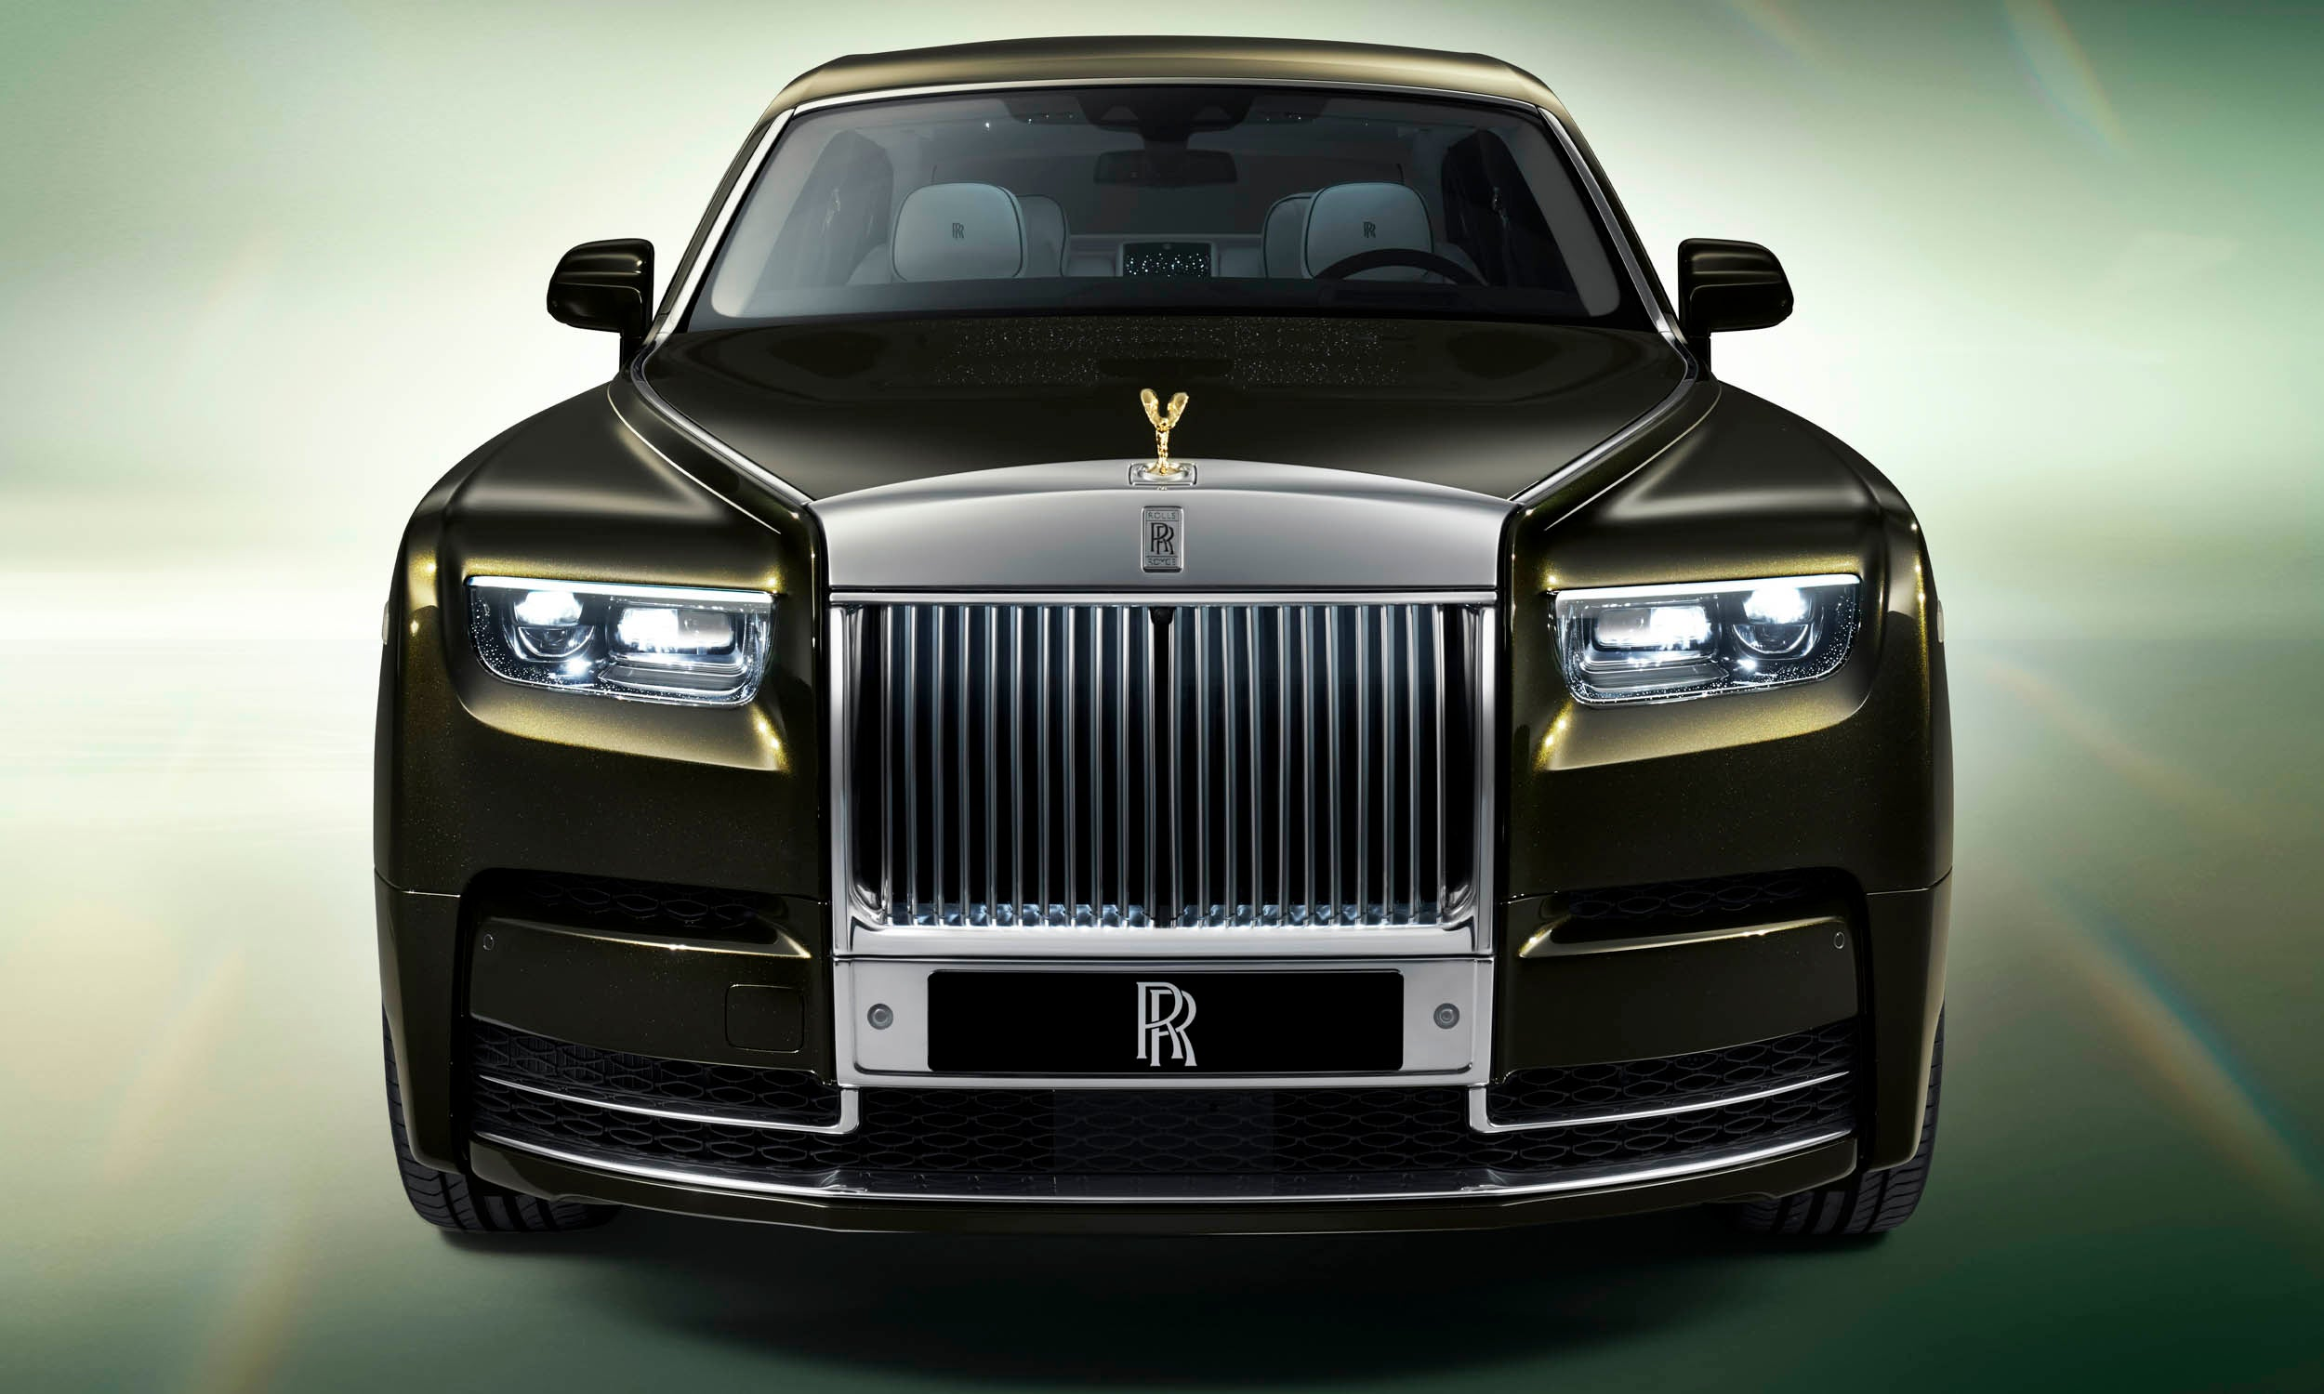
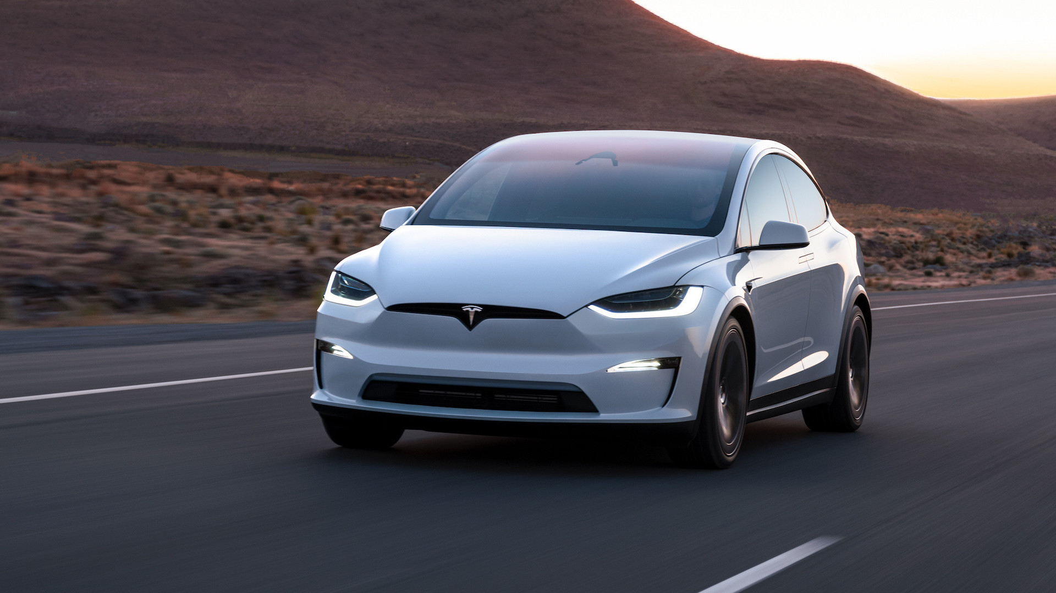
Insight Required: How does the average price of a car vary across different manufacturers?
4.A: Create a pivot table that shows the average price of cars for each manufacturer.
4.B: Create a bar chart or a horizontal stacked bar chart that visualizes the relationship between manufacturer and average price.
Price ≠ Quality: Some luxury brands (e.g., Tesla) command premiums for innovation, while others (e.g., Rolls-Royce) sell exclusivity.
Market Segmentation: Brands like Toyota and Bugatti operate in entirely different universes—volume vs. rarity.
Disruptors: Tesla’s $85K average MSRP shows how EVs can redefine pricing in legacy segments.

Slide 13
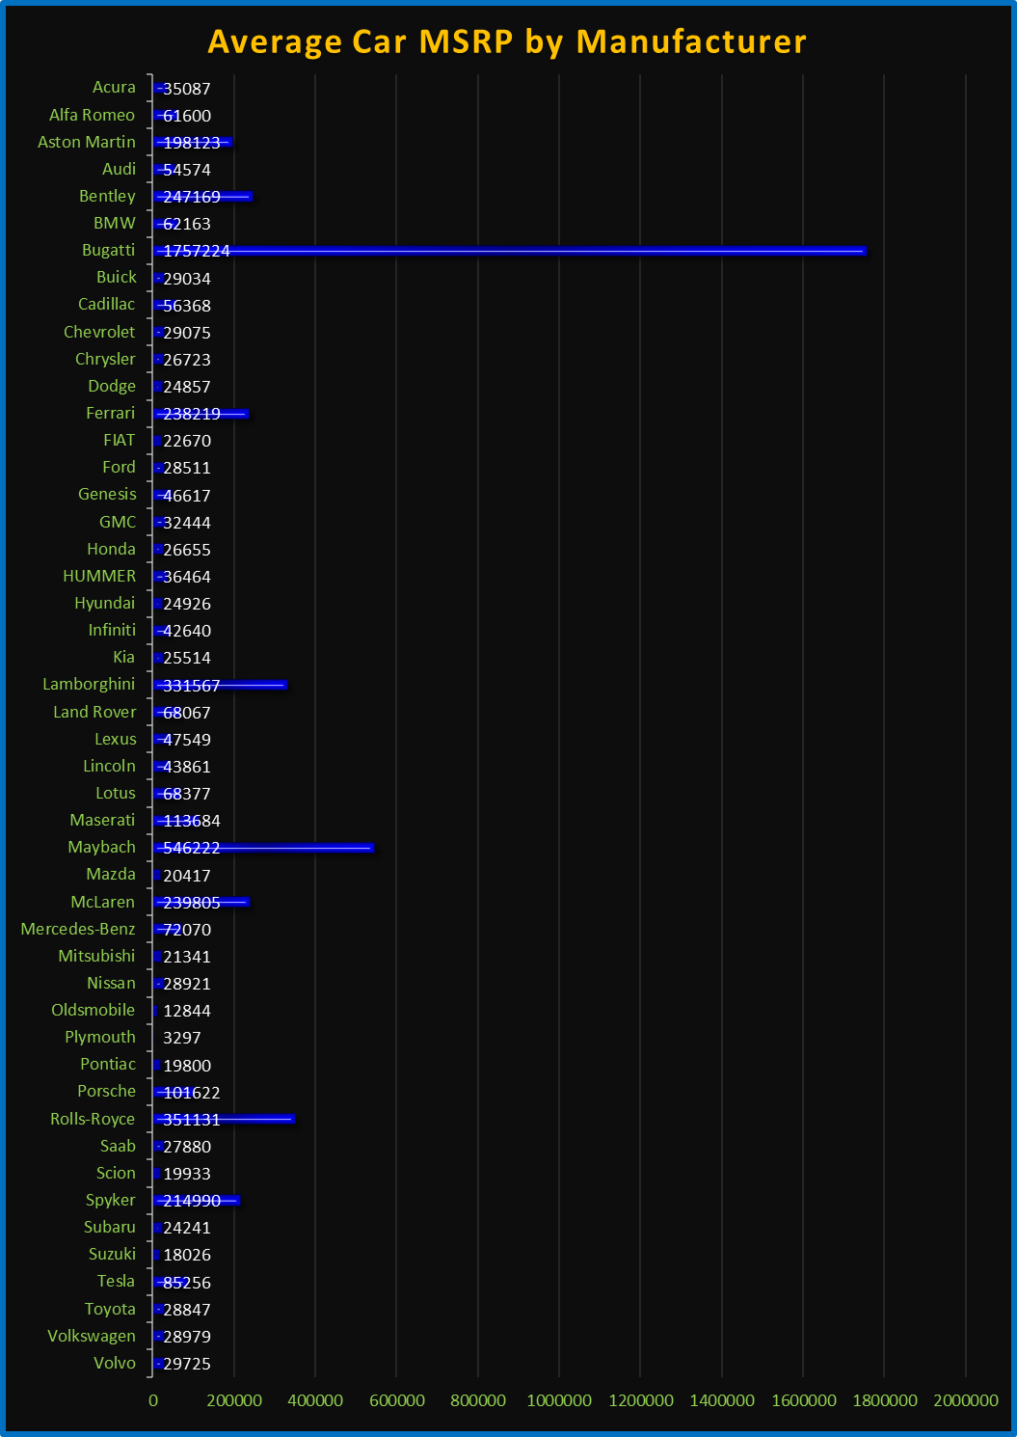
The average car price varies dramatically across manufacturers:
Ultra-Luxury & Exotic Brands:
Bugatti (1,757,224)
Rolls-Royce (351,131)
Maybach (546,222)
Lamborghini (331,567)
McLaren (239,805)
Ferrari (238,219) Why? Handcrafted exclusivity, high-performance engineering, and prestige branding.
Premium Luxury Brands:
Porsche (101,622)
Tesla (85,256) – EV premium
Mercedes-Benz (72,070)
Maserati (113,684) Why? Advanced tech, luxury features, and strong brand equity.
Mainstream Luxury:
Lexus (47,549)
BMW (62,163)
Audi (54,574) Why? Balance of luxury and practicality, targeting affluent but not ultra-high-net-worth buyers.
Mass-Market Brands:
Toyota (28,847)
Honda (26,655)
Ford (28,511) Why? High volume, affordability, and reliability focus.
Budget Brands:
Suzuki (18,026)
Plymouth (3,297) – discontinued, historic low
Scion (19,933) – discontinued Why? Economical, no-frills transportation.

Slide 14
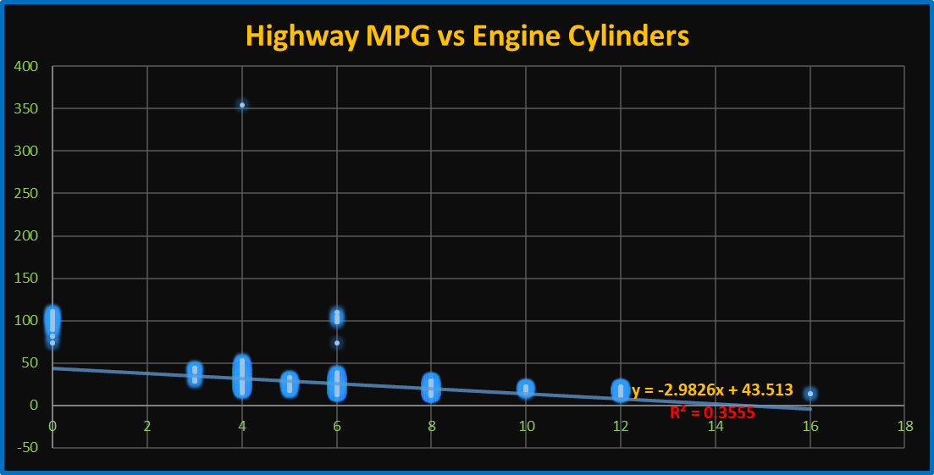
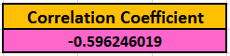
Insight Required: What is the relationship between fuel efficiency and the number of cylinders in a car's engine?
5.A: Create a scatter plot with the number of cylinders on the x-axis and highway MPG on the y-axis. Then create a trendline on the scatter plot to visually estimate the slope of the relationship and assess its significance.
5.B: Calculate the correlation coefficient between the number of cylinders and highway MPG to quantify the strength and direction of the relationship.
The value of -0.596 indicates a moderate to strong negative correlation between the two variables being analyzed.
The negative sign means that as one variable increases, the other tends to decrease (inverse relationship).
The equation y=−2.9826x+43.513 shows that as the number of engine cylinders increases, highway MPG decreases.
The R2=0.3555R2=0.3555 indicates that 35.55% of the variability in MPG is explained by cylinder count.
Cylinders alone don’t fully predict MPG—other factors (weight, transmission, fuel type) also play significant roles.

Slide 15
Dashboard
Task 1: How does the distribution of car prices vary by brand and body style?

Slide 16
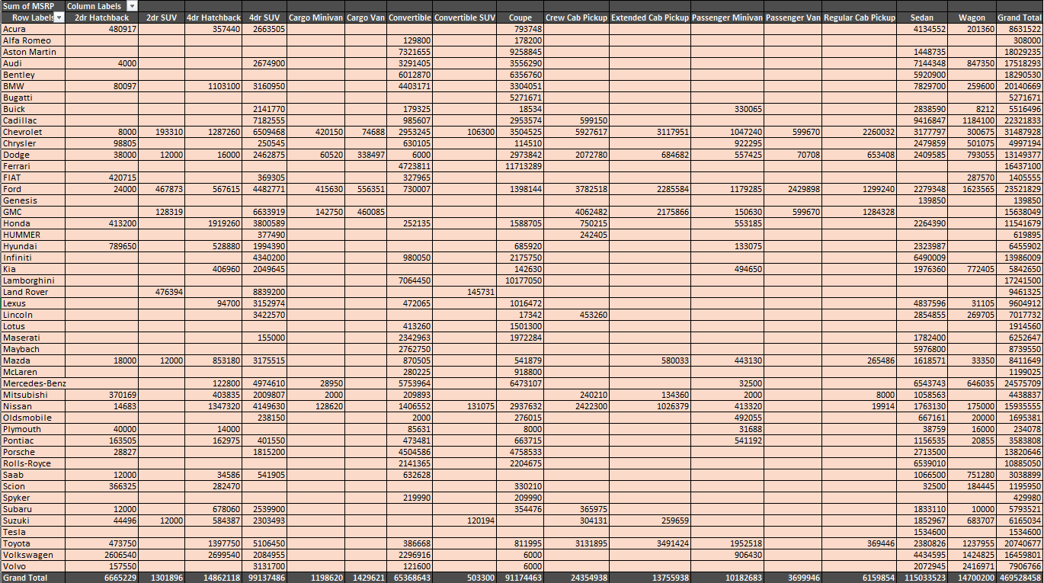

Slide 17
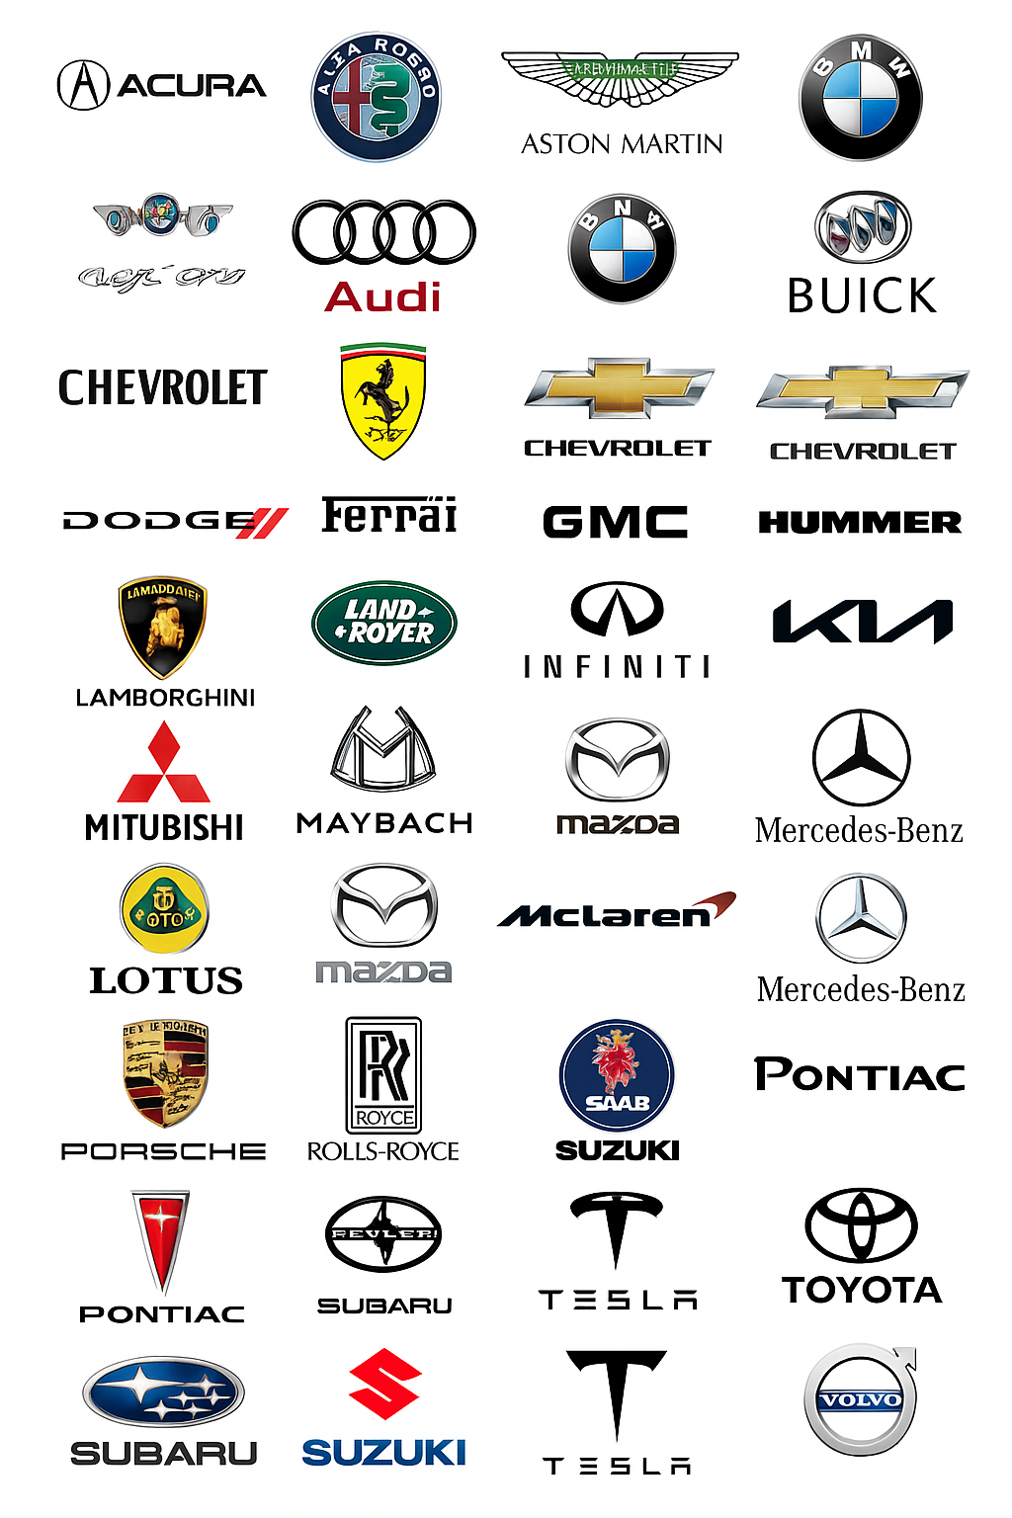
Price Variation by Brand:
Ultra-Luxury Brands (Bugatti, Rolls-Royce, Lamborghini)
Highest Prices: Focus on convertibles, coupes, and SUVs with limited editions.
Example: A Bugatti convertible costs exponentially more than mainstream brands’ equivalents.
Mainstream Luxury (BMW, Mercedes-Benz, Audi)
Broad Range: SUVs (4d5, Crew Cab) and sedans dominate, with prices scaling by features.
Example: A BMW SUV may cost 2–3× more than a Toyota SUV of the same body style.
Economy Brands (Toyota, Honda, Hyundai)
Lowest Prices: Regular cab pickups, hatchbacks, and minivans are most affordable.
Price Variation by Body Style:
Most Expensive Styles:
Convertibles (luxury-focused)
Crew Cab Pickups (high-demand utility)
4d5 SUVs (family/premium segment)
Most Affordable Styles:
Regular Cab Pickups (work-oriented)
Cargo Vans/Minivans (commercial use)
Hatchbacks (compact/economy)

Slide 18
Task 2: Which car brands have the highest and lowest average MSRPs, and how does this vary by body style?

Slide 19
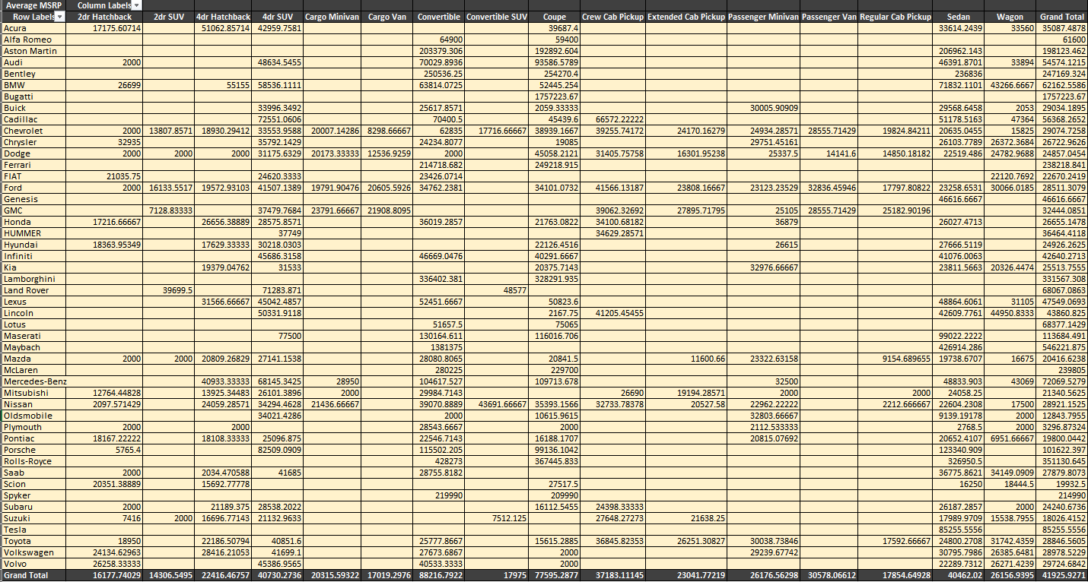

Slide 20
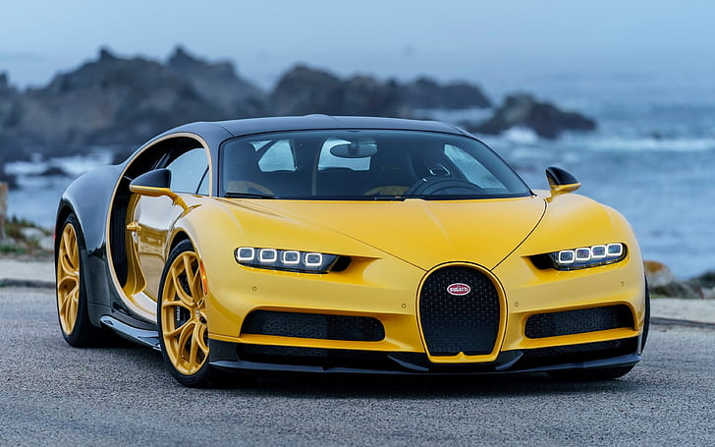
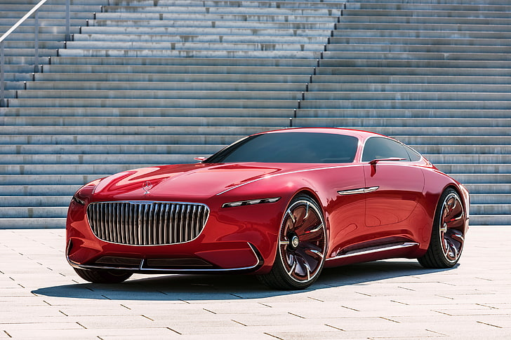
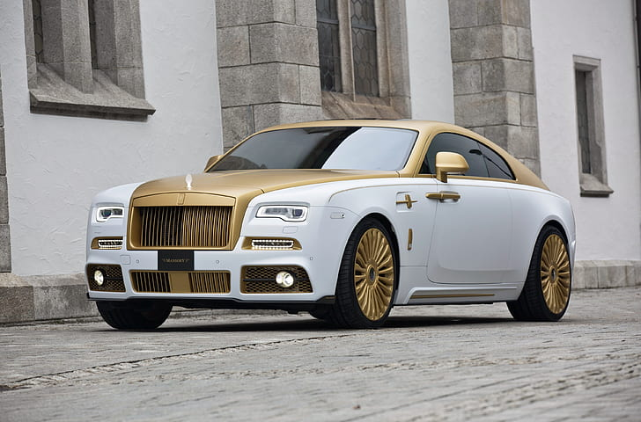
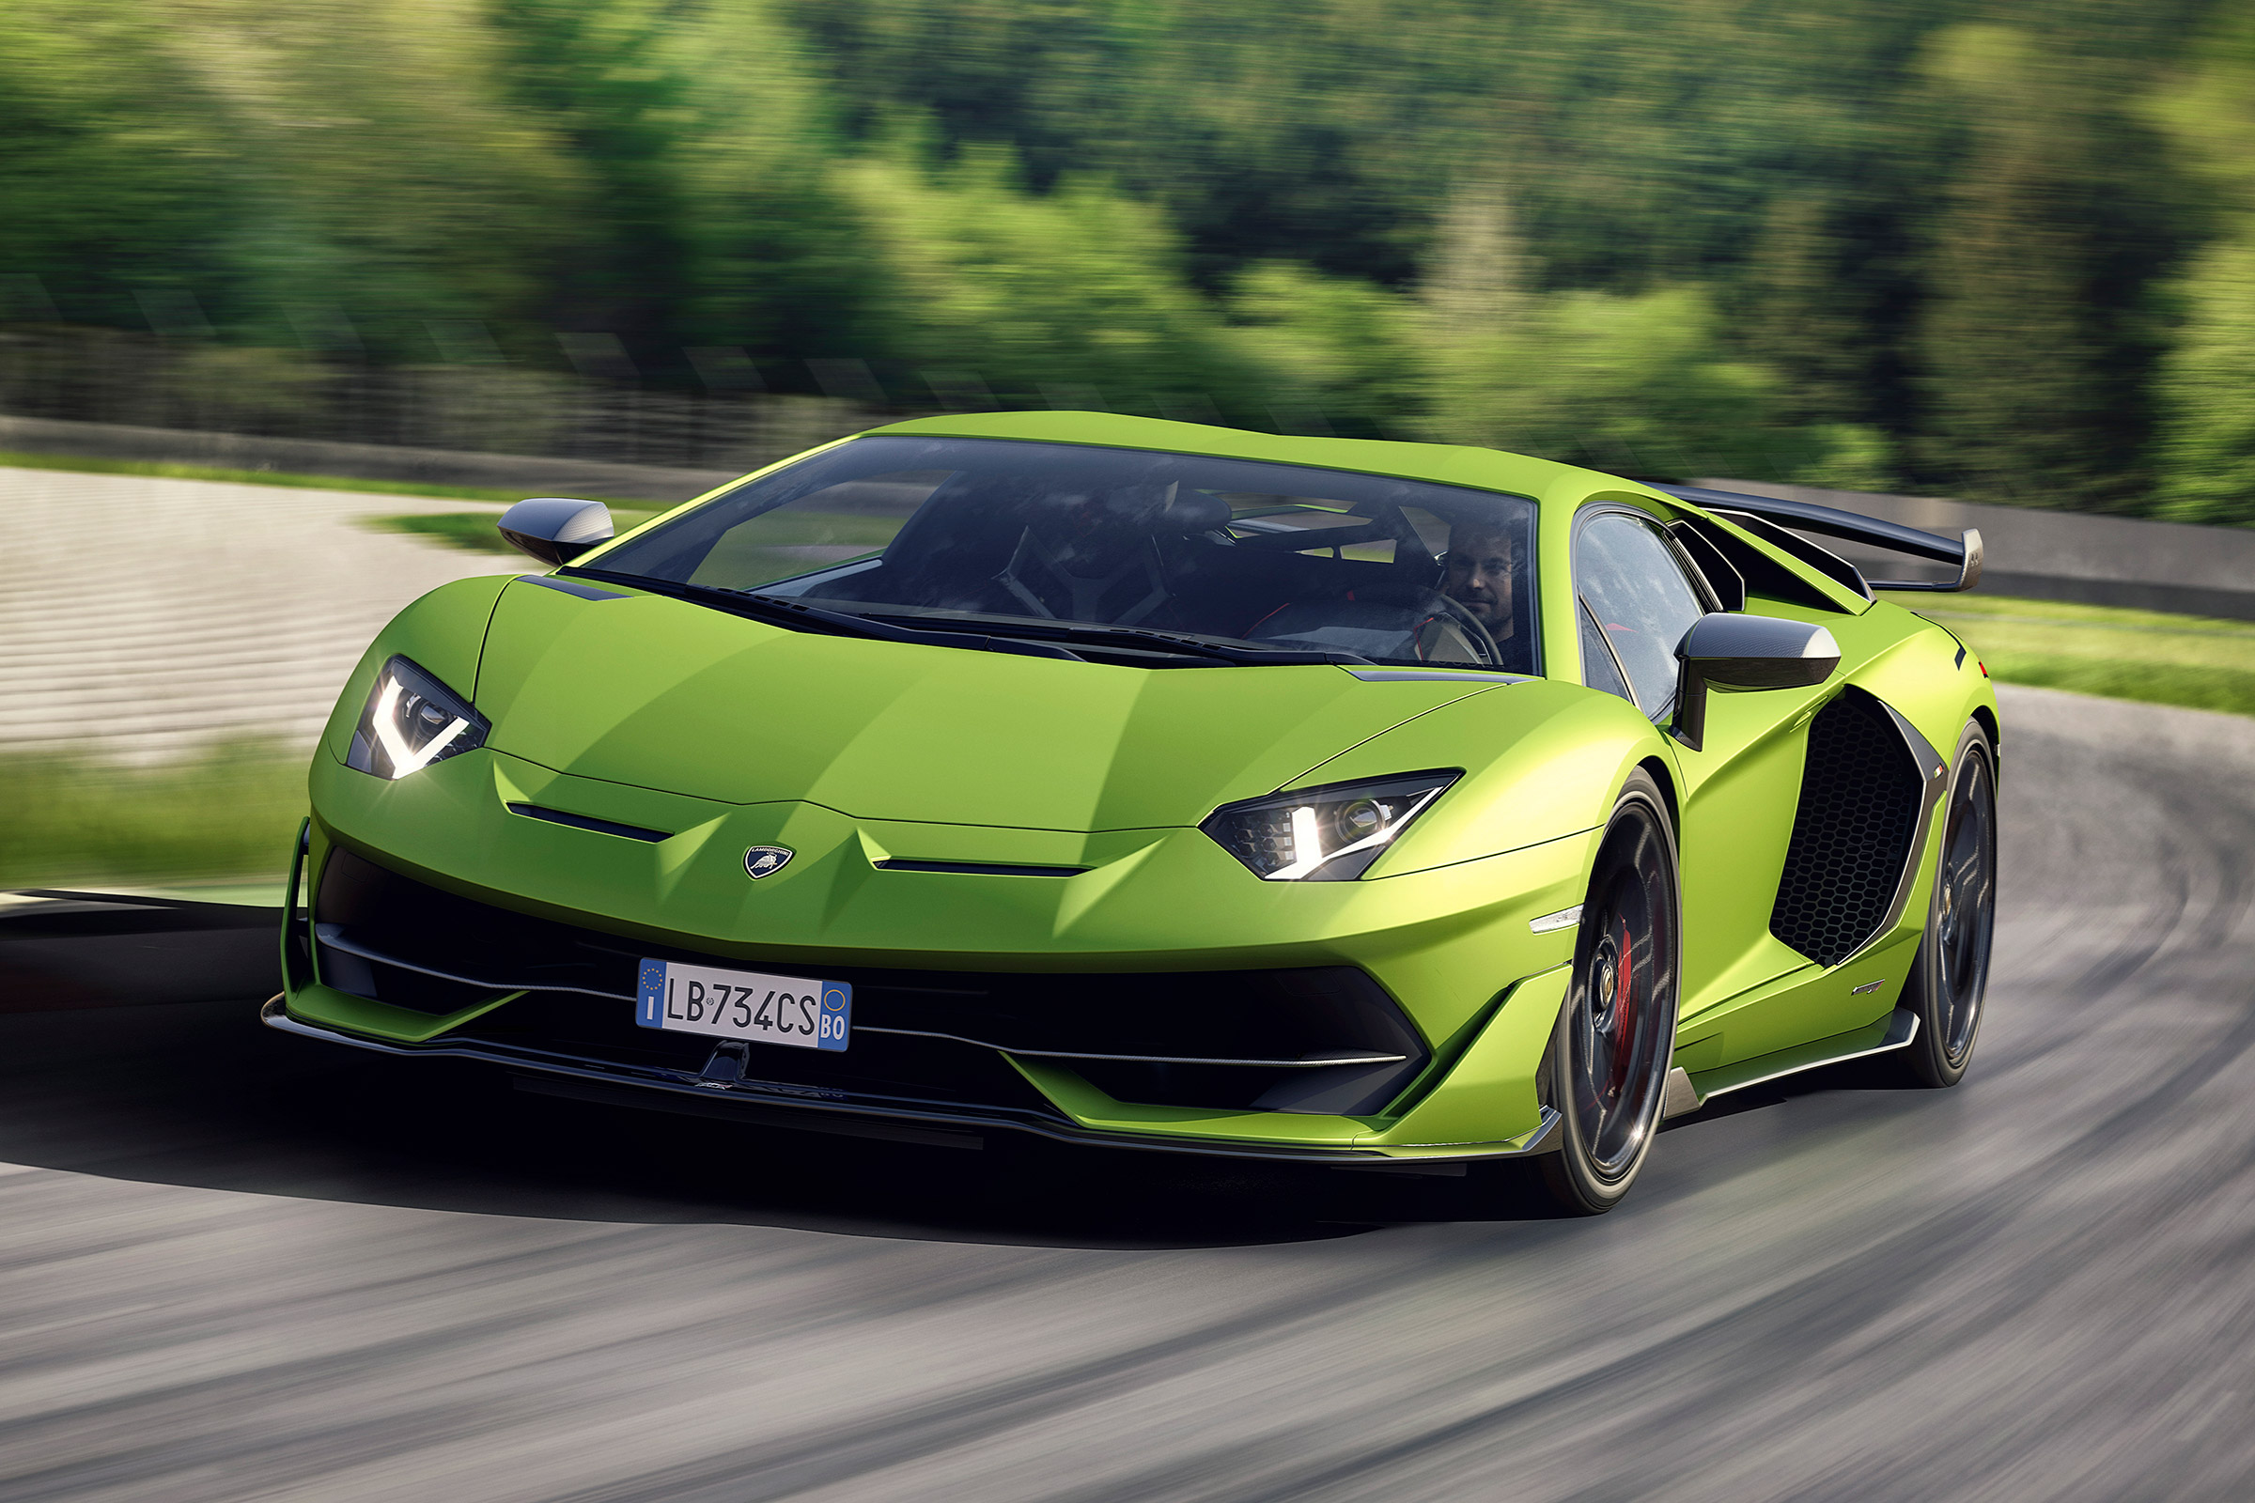
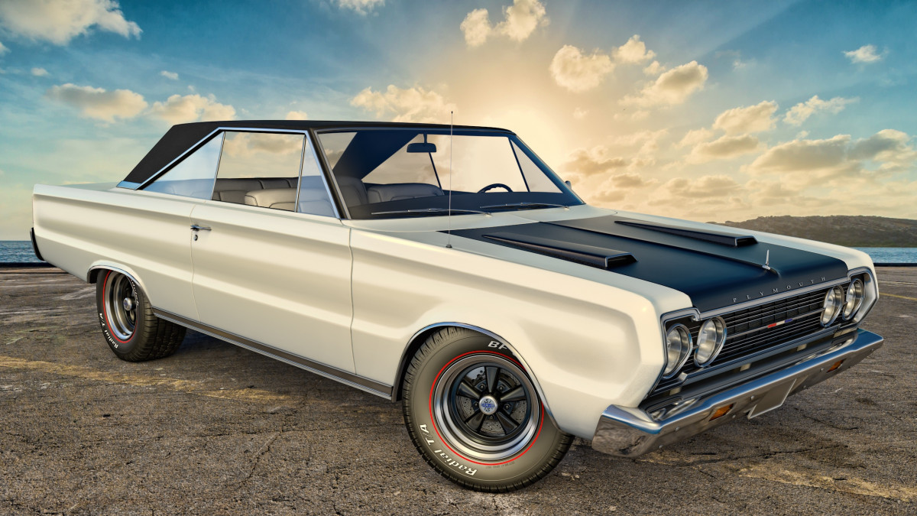
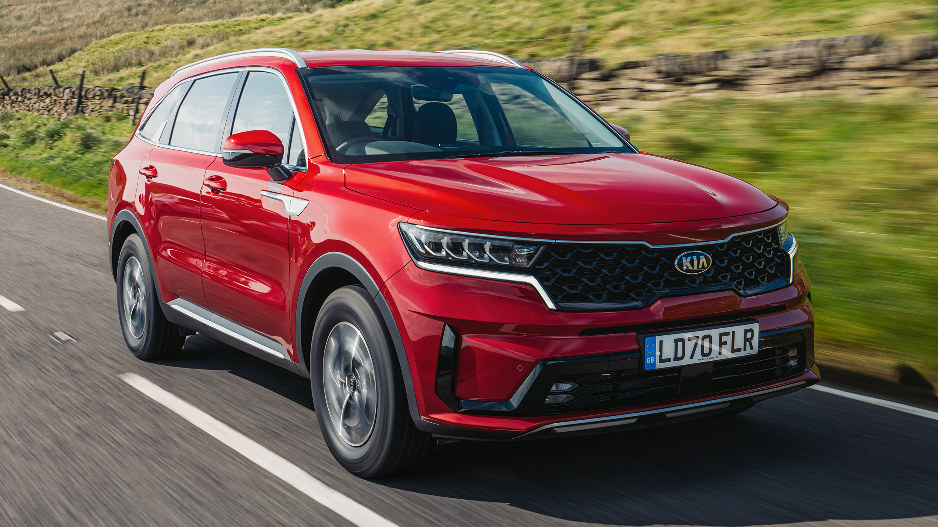
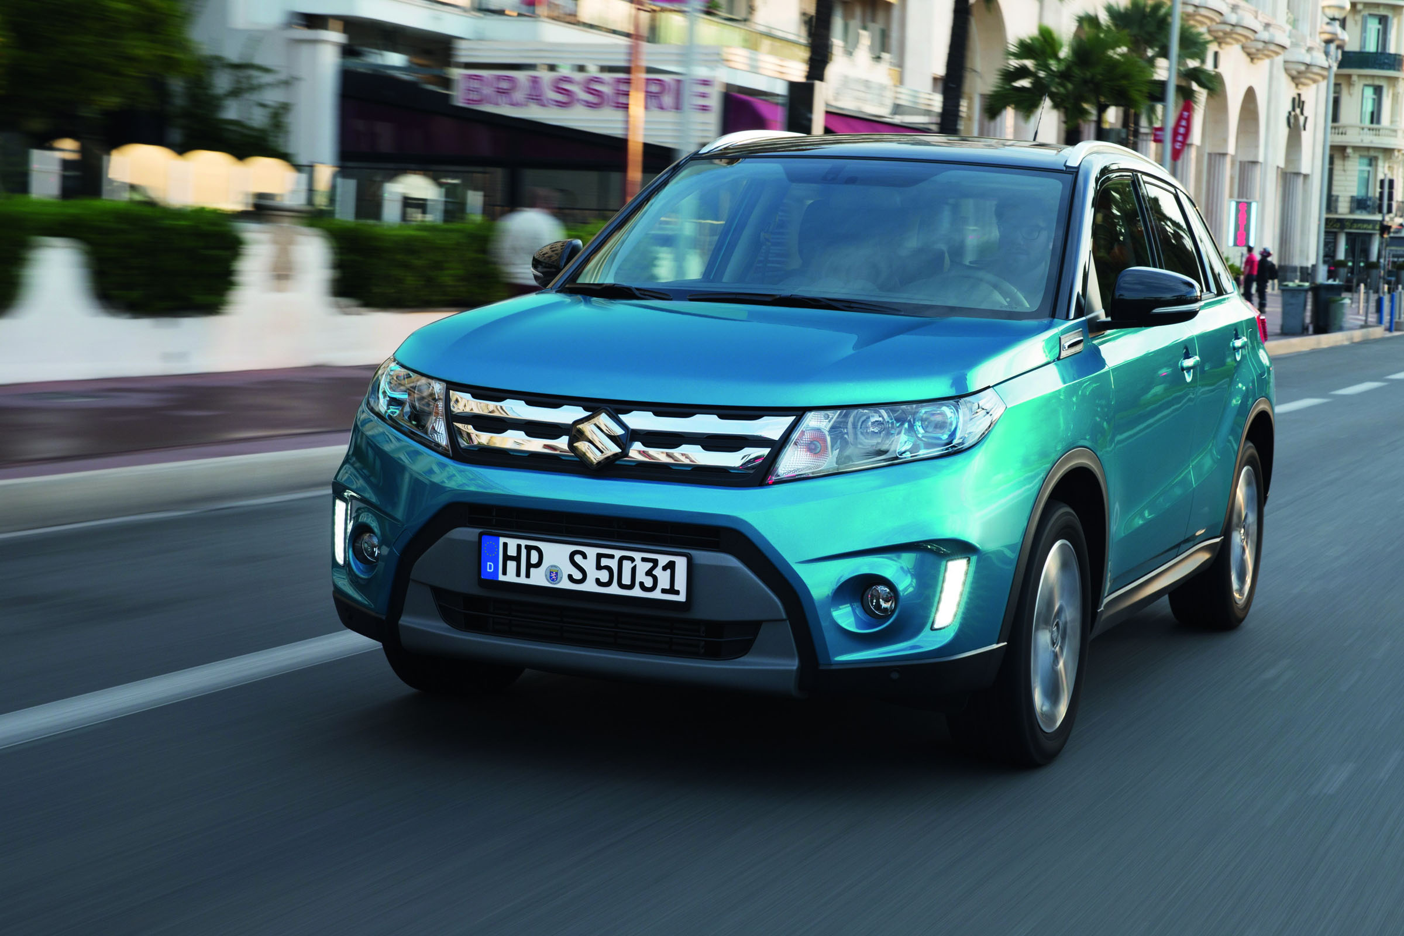
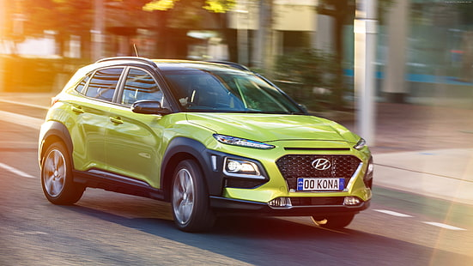
Highest Average MSRP Brands:
Bugatti
MSRP: ~1,757,224
Body Styles: Convertibles/Coupes (ultra-exclusive).
Rolls-Royce
MSRP: ~351,131
Body Styles: Luxury SUVs , Sedans.
Lamborghini
MSRP: ~331,567
Body Styles: Convertible SUVs , Coupes.
Maybach
MSRP: ~546,222
Body Styles: Luxury Sedans , SUVs.
Why? Handcrafted materials, limited production, and prestige branding.
Lowest Average MSRP Brands
Plymouth (Discontinued)
MSRP: ~3,297
Body Styles: Compact Sedans, Minivans.
Suzuki
MSRP: ~18,026
Body Styles: Hatchbacks, Compact SUVs.
Kia/Hyundai
MSRP: ~25,514
Body Styles: Sedans , Cargo Vans.
Why? Mass-market focus, affordability, and high-volume production.

Slide 21
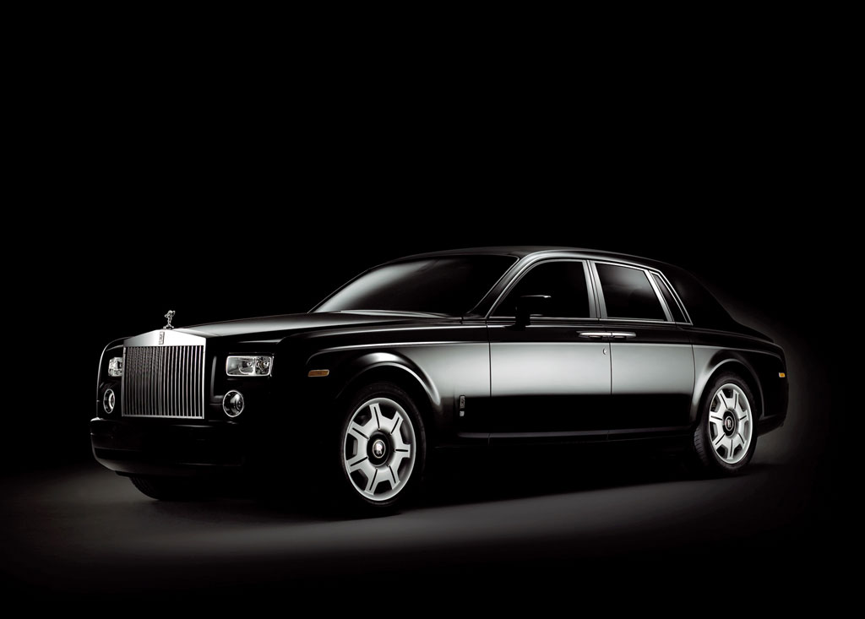
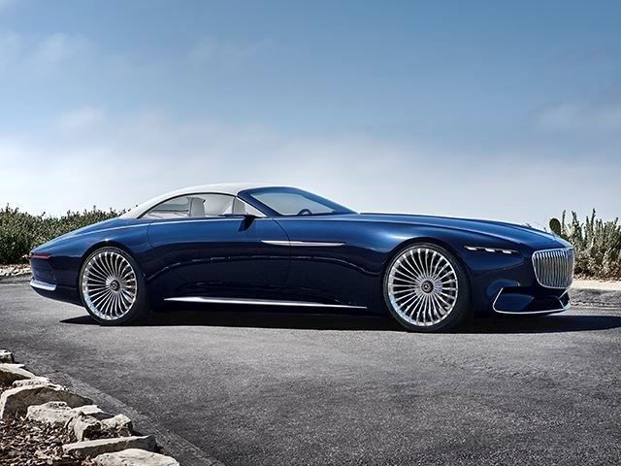
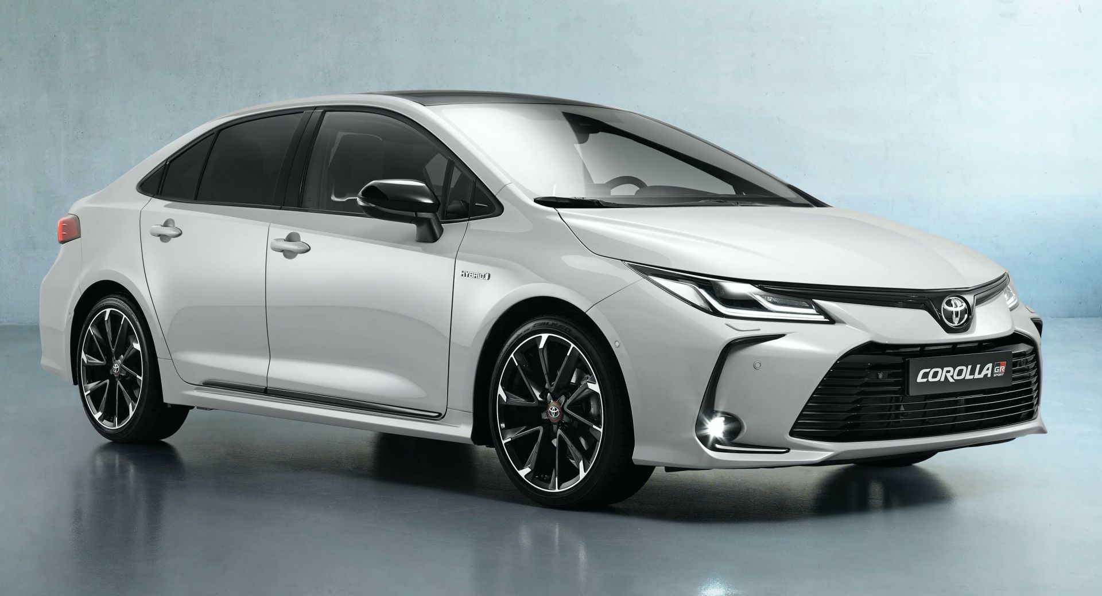
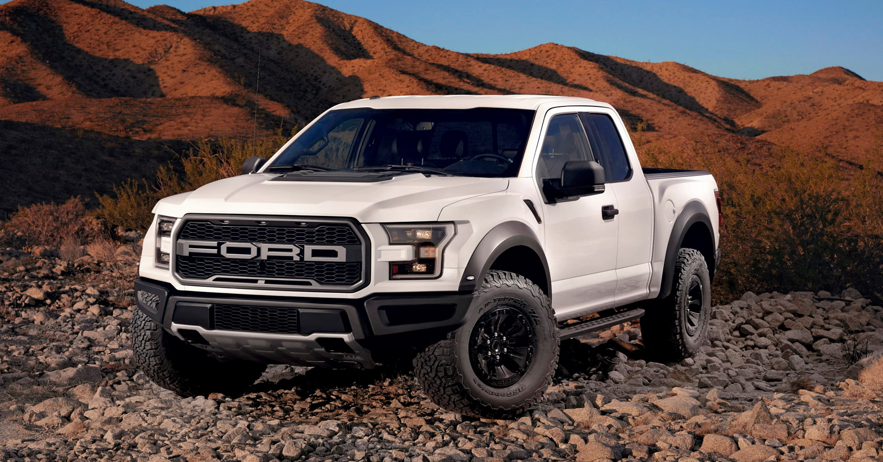
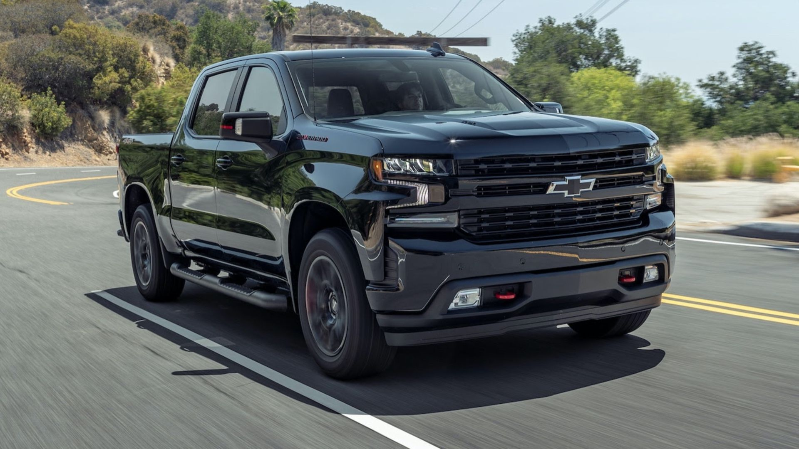
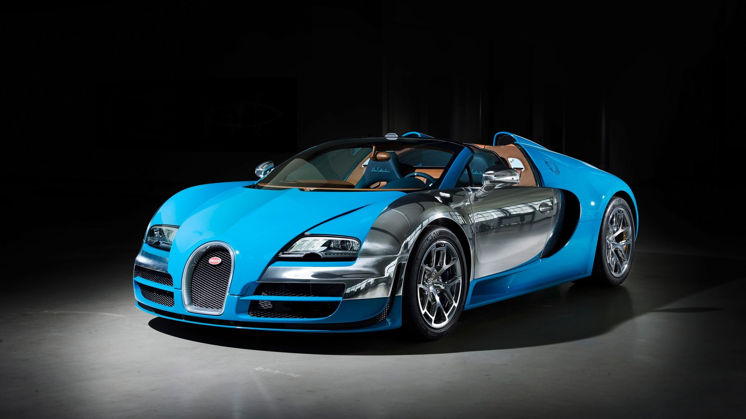
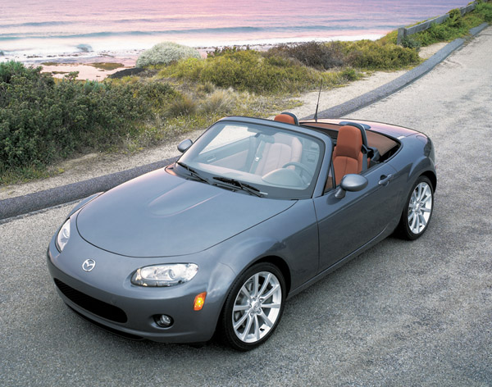
Variation by Body Style
Body Style | Highest MSRP Example | Lowest MSRP Example
SUV | Rolls-Royce (351,131) | Kia (25,514)
Sedan | Maybach (546,222) | Toyota (28,847)
Pickup (Crew Cab) | Ford (28,511) | Chevrolet (29,075)
Convertible | Bugatti (1,757,224) | Mazda (20,417)

Slide 22
Task 3: How do the different feature such as transmission type affect the MSRP, and how does this vary by body style?

Slide 23
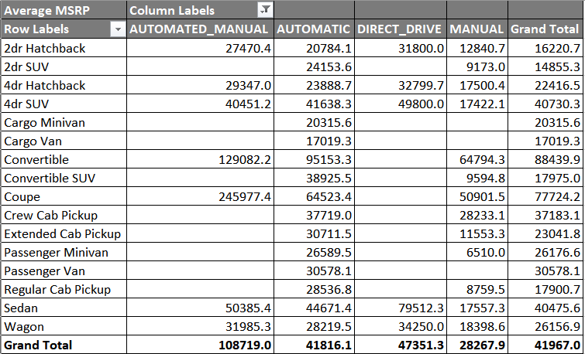
Transmission Type’s Effect on Average MSRP
Transmission | Avg. MSRP | Premium Over Manual | Typical Use Cases
AUTOMATED_MANUAL | 108,719 | +285% vs. Manual | High-performance, luxury vehicles
DIRECT_DRIVE | 47,351 | +67% vs. Manual | EVs (e.g., Tesla)
AUTOMATIC | 41,816 | +48% vs. Manual | Mainstream sedans/SUVs
MANUAL | 28,268 | Baseline | Budget/enthusiast models

Slide 24
AUTOMATED_MANUAL commands the highest premium (e.g., supercars like Ferraris).
MANUAL is the most affordable, but availability is shrinking (e.g., base trims or sports cars).
Variation by Body Style
Body Style | Most Expensive Transmission | Cheapest Transmission | Price Gap
Coupe | AUTOMATED_MANUAL (245,977) | MANUAL (50,902) | +383%
Convertible | AUTOMATED_MANUAL (129,082) | MANUAL (64,794) | +99%
Sedan | DIRECT_DRIVE (79,512) | MANUAL (17,557) | +353%
4dr SUV | DIRECT_DRIVE (49,800) | MANUAL (17,422) | +186%
Cargo Van | AUTOMATIC (17,019) | N/A (Manual not offered) | —
Luxury/Performance Styles:
Coupes/convertibles with AUTOMATED_MANUAL have extreme premiums.
Mainstream Styles:
AUTOMATIC dominates (e.g., SUVs, pickups), with modest price jumps over manual.
EV Influence:
DIRECT_DRIVE (EVs) raises sedan/SUV prices.

Slide 25
Task 4: How does the fuel efficiency of cars vary across different body styles and model years?

Slide 26
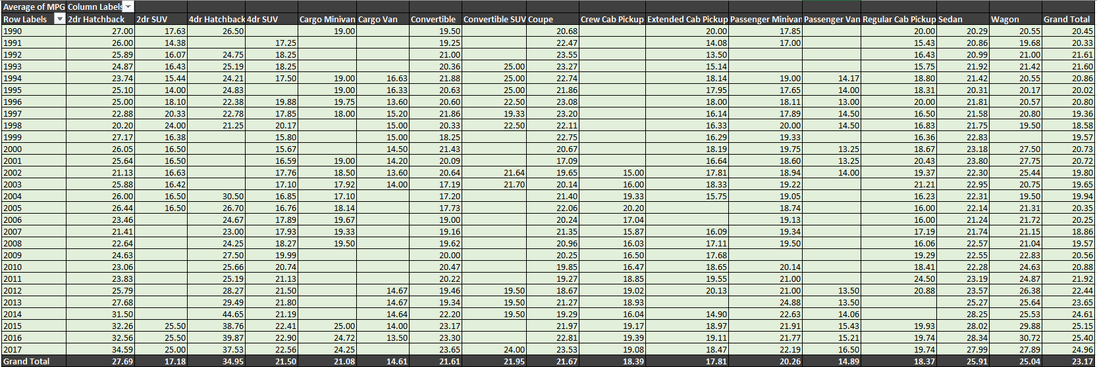
Model Year Trends (1990–2017)
1990–1999:
Gasoline dominance: Low MPG (e.g., 1995 Ford Explorer: 17 MPG).
Manual transmissions were common in economy cars (e.g., 1998 Honda Civic: 32 MPG).
2000–2009:
Hybrids introduced: Toyota Prius (2000: 41 MPG) revolutionized efficiency.
SUVs peaked in size (e.g., 2006 Hummer H2: 12 MPG).
2010–2017:
CAFE standards enforced: Fleet-wide MPG rose ~5 MPG (2010: 22.5 MPG → 2017: 27.5 MPG).
Turbocharging mainstreamed: Ford F-150 (2015: 22 MPG vs. 2005: 16 MPG).

Slide 27
Body Style Impact on MPG
(From Most to Least Efficient)
Body Style | Avg. MPG (1990s) | Avg. MPG (2010s) | Change | Key Factors
2dr Hatchback | 28–32 MPG | 32–38 MPG | +14% | Lightweight, improved aerodynamics
Sedan | 24–28 MPG | 28–34 MPG | +17% | Engine tech (VVT, direct injection)
Wagon | 22–26 MPG | 26–32 MPG | +18% | Hybrid variants (e.g., Prius V)
Minivan | 18–22 MPG | 20–26 MPG | +12% | Lighter materials, 6-speed transmissions
SUV (4dr) | 16–20 MPG | 18–26 MPG | +25% | Shift to unibody designs (e.g., Honda CR-V)
Pickup (Crew Cab) | 14–18 MPG | 16–22 MPG | +22% | Turbocharged V6s (e.g., Ford EcoBoost)
Convertible | 18–22 MPG | 20–28 MPG | +15% | Structural efficiency gains
Efficiency Gains Were Universal: All body styles improved, but SUVs/pickups benefited most from tech (turbocharging, unibody designs).
Hybrids Reshaped the Market: Post-2000, hybrids made hatchbacks/sedans 30%+ more efficient than 1990s counterparts.
Regulations Worked: CAFE standards drove ~25% MPG gains in trucks/SUVs (2010s vs. 1990s).

Slide 28
Task 5: How does the car's horsepower, MPG, and price vary across different Brands?

Slide 29
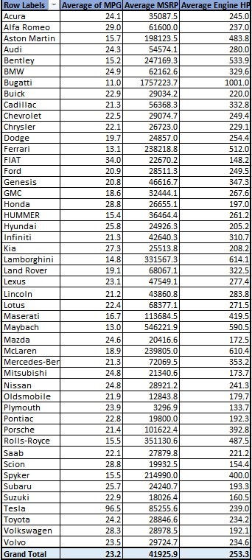
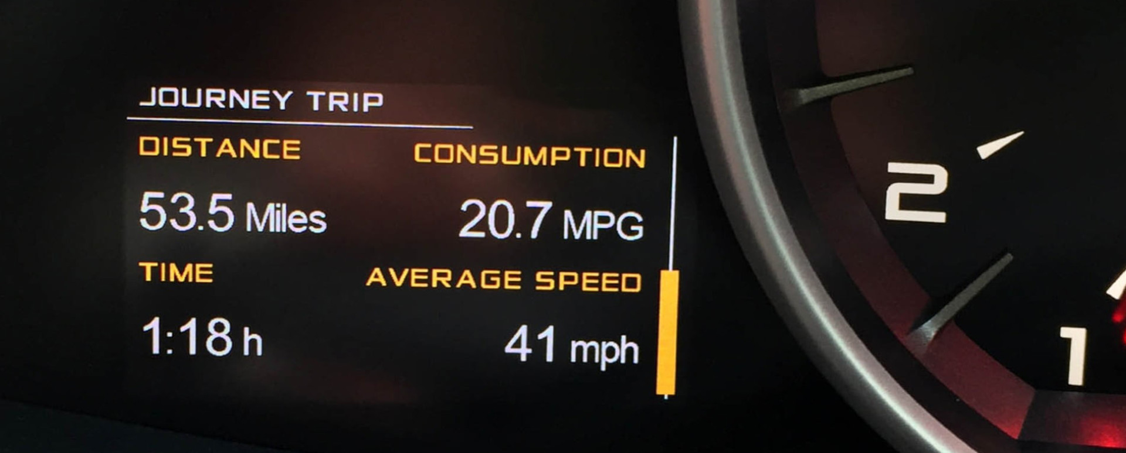
Fuel Efficiency (Average of MPG):
Highest MPG Brands:
Tesla (96.5 MPG) – This is exceptionally high, likely due to Tesla being fully electric.
FIAT (34.0 MPG) and Alfa Romeo (29.0 MPG) – These brands focus on smaller or more efficient engines.
Honda (28.8 MPG) and Scion (28.8 MPG) – Known for reliable, fuel-efficient vehicles.
Lowest MPG Brands:
Bugatti (11.0 MPG) – High-performance, large engines.
Maybach (13.0 MPG) and Ferrari (13.1 MPG) – Luxury/sports cars with powerful engines.
Bentley (15.2 MPG) and Rolls-Royce (15.5 MPG) – Heavy luxury vehicles.

Slide 30
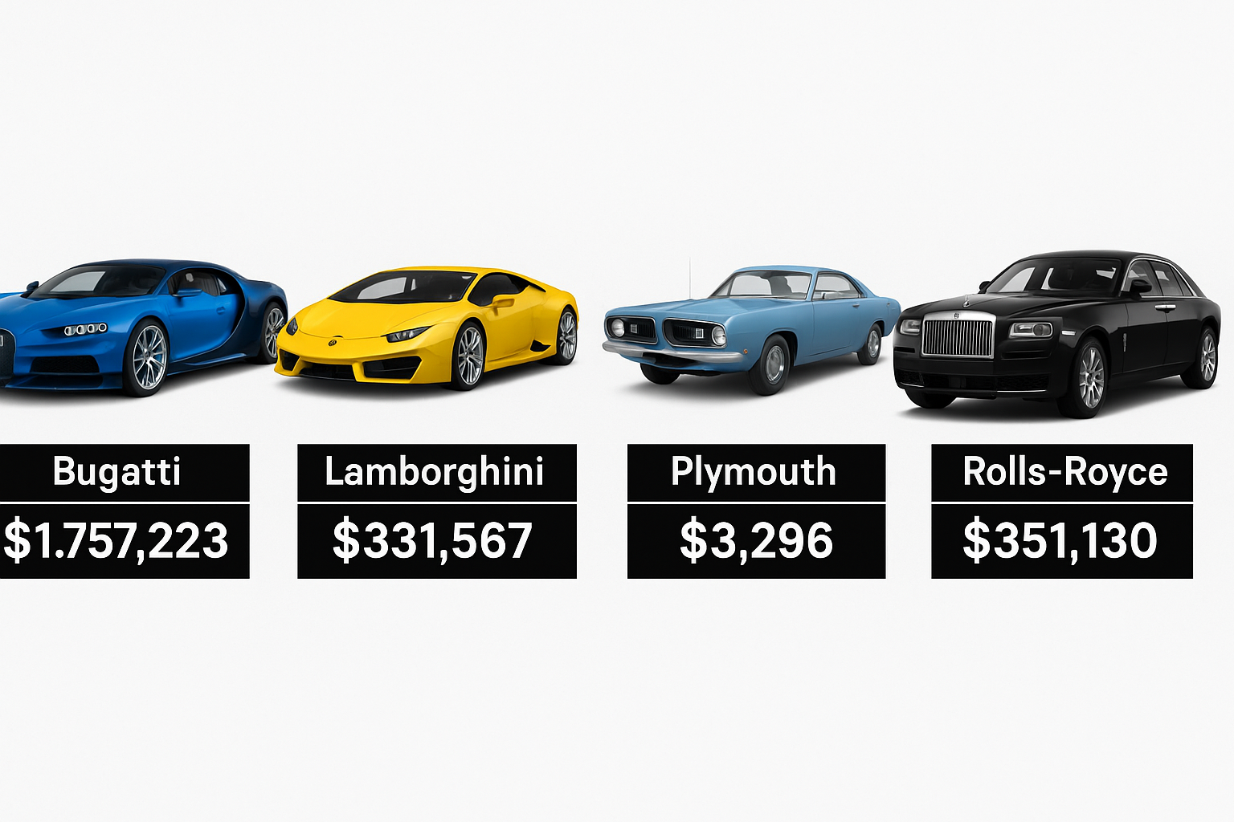
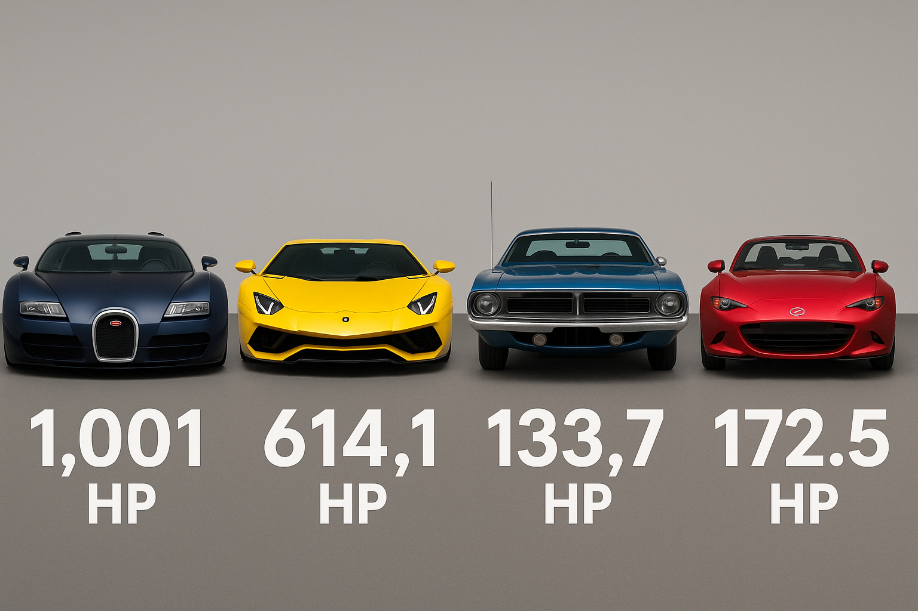
Price (Average MSRP):
Most Expensive Brands:
Bugatti (1,757,223.7) – Ultra-luxury hypercars.
Maybach (546,221.9) and Rolls−Royce (546,221.9) and
Rolls−Royce (351,130.6) – High-end luxury.
Lamborghini (331,567.3) and Ferrari (331,567.3) – Exotic sports cars.
Most Affordable Brands:
Plymouth ($3,296.9) – Likely older or discontinued models.
Oldsmobile (12,843.8) and Suzuki (12,843.8) and Suzuki (18,026.4) – Budget-friendly options.
Scion (19,932.5) and Mazda (19,932.5) and Mazda (20,416.6) – Economical brands.
Horsepower (Average Engine HP):
Most Powerful Brands:
Bugatti (1,001 HP) – Extreme performance.
Lamborghini (614.1 HP) and McLaren (610.4 HP) – High-performance sports cars.
Maybach (590.5 HP) and Ferrari (512.0 HP) – Luxury/supercars.
Least Powerful Brands:
Plymouth (133.7 HP) – Older or economy-focused.
FIAT (148.2 HP) and Scion (154.4 HP) – Compact, efficient vehicles.
Mazda (172.5 HP) and Mitsubishi (173.7 HP) – Balanced performance.

Slide 31
Results and Conclusion
Market Demand: Diesel and Flex Fuel cars, though fewer in number, show high popularity, while Luxury cars have many models but low demand—indicating misalignment between supply and consumer interest.
Performance & Price: A strong positive relationship exists between engine horsepower and price—buyers are willing to pay more for performance.
Key Price Drivers: Horsepower and cylinder count significantly raise prices. In contrast, fuel efficiency (MPG) is linked to lower-cost vehicles.
Brand Impact: Car prices vary widely by brand. Luxury and exotic brands command premiums for performance and exclusivity, while mass-market brands offer affordability and reliability.
Fuel Efficiency vs. Engine Design: More engine cylinders lead to lower MPG, with a moderate negative correlation. Other factors like weight and design also affect efficiency.
We Conclude that Car performance features, especially horsepower, are key drivers of price. High-demand, fuel-efficient models represent growth opportunities, while oversupplied luxury categories may need strategy shifts. Brand, engine design, and market segment all play crucial roles in pricing and profitability.

Slide 32


